Slide 1







Tourist intelligence
Analysis Using AI and ML Models
By : Ghaith Salameen
Supervised by : Maysa Khalil

Slide 2



Table Of Contents
01
Future IdeasFuture Ideas
Introduction
05
Model Performance Comparison
02
Data Exploration
06
Future Ideas
03
Data Preprocessing
04
Models Used
07
Conclusions

Slide 3


01
Introduction
• Goal : Predict tourist arrivals
• Using data from 2022, 2023, and World Bank
• Analysis, cleaning, and predictive modeling

Slide 4



02
Data Exploration
203 rows (countries) & 6 columns :
country name, predicted arrivals (M) 2023 arrivals (M), 2022 arrivals (M), World Bank arrivals, and World Bank data year
Large proportion of missing values
Main columns include : Country & Arrivals

Slide 5




Data Preprocessing
03
Missing Value : Fill from previous year
Use KNN to imputemissing values

Slide 6





04
Used Models
Decision Tree
Random Forest
Linear Regression
Support Vector Regression
Recurrent Neural Network
Artificial Neural Network

Slide 7

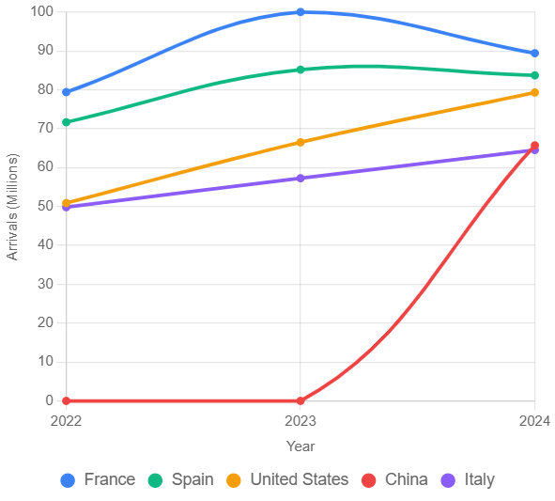
Top 5 Countries

Slide 8

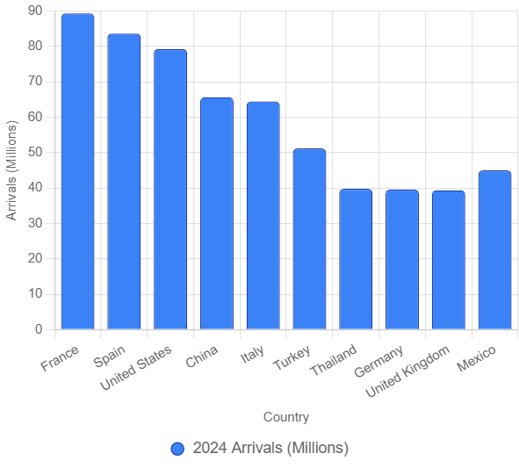

Top 10 Countries

Slide 9

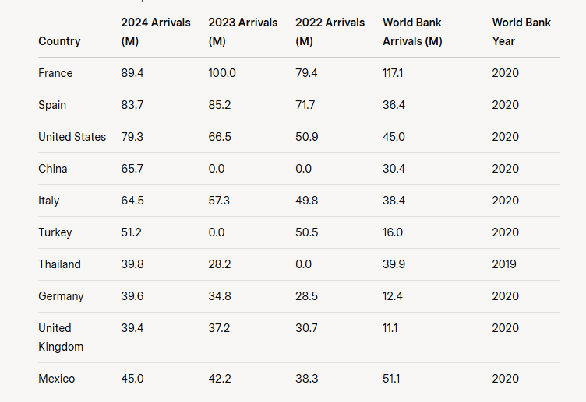
Data for the
top 10 countries :

Slide 10



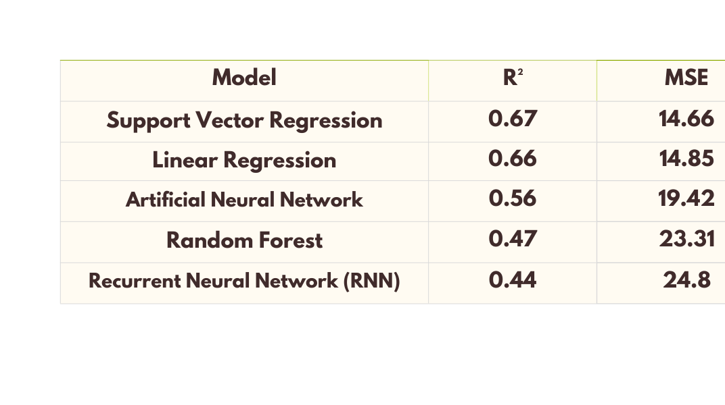
05
Model Performance Comparison

Slide 11










06
Future Ideas
Add economic and tourism data
Optimize models via search techniques
Try LSTM for RNN
improvements

Slide 12

07
Conclusions
Data quality affects accuracy
Simple models gave better results
RNN improved results

Slide 13


Thank
you

